Slide 1
Fabric Complex Processes Monitor V1 Implementation
a.k.a “Migration Monitor”

Slide 2
Contents
How it works
Package contents
Implementation Steps

Slide 3
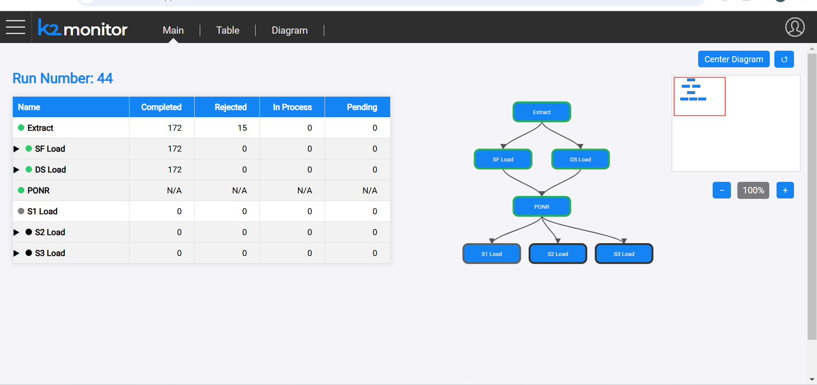
How It Works – Overview
The Process Monitor is a web app integrated with the Fabric web framework.
The process stages table and flow diagram is derived from configuration
Mtable, and status updates are received via web-services.

Slide 4
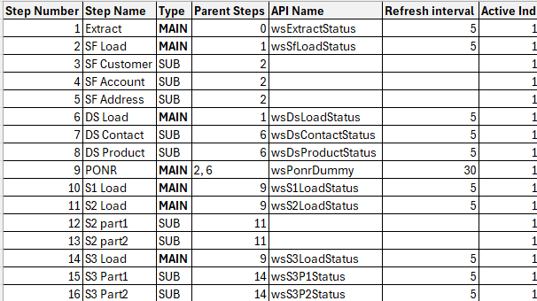
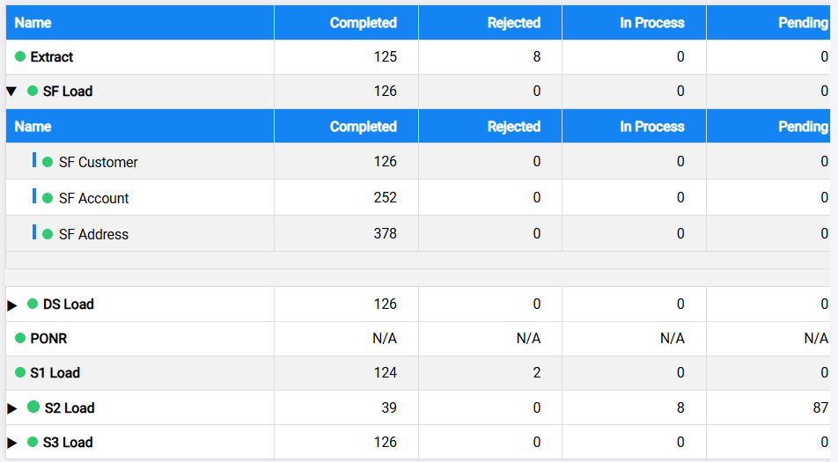
How It Works
The configuration MTable is filled as part of the project implementation.
The monitor gets the configuration contents and draws the monitor page.
Each step status and numbers of objects in pending/in-process/rejected/completed states is retrieved by calling the API specified in the configuration MTable:

Slide 5
Package Contents (part 1)
The Monitor K2Export file contains the following items:
Monitor LU
MTables –
mtMonitorConfig – main monitor configuration MTable
mtMonitorBatchStatus – optional MTable, translating the results of a batch-status to the monitor expected status – for use in the implementation if/when required.
Web Services
Java file monitor/Logic.java – containing Monitor WS framework:
wsMonitorConfig – returns the contents of mtMonitorConfig
wsExecId – place-holder for mandatory WS; must be implemented by as part of the project implementation
wsProcStatusExample – dummy WS, providing Hard-coded example of the data that a process-status WS should return
These items should be imported into any project that wishes to use the monitor.

Slide 6
Package Contents (continued)
The Monitor LU also contains a “web/monitor” folder which does not appear on the Studio.
The files in this folder include the implementation of the monitor:
Index.html
These items should be imported into any project that wishes to use the monitor.

Slide 7
Implementation Steps (part 1 – high-level)
To implement the monitor in a Fabric project, follow these steps:
Import into the Project all the items specified in the “Package Contents” section of this document from the Monitor_v1.k2export
On the Fabric server “apps.json” file, add the Monitor application
Fill mtMonitorConfig and create the related WSs according to the project needs

Slide 8
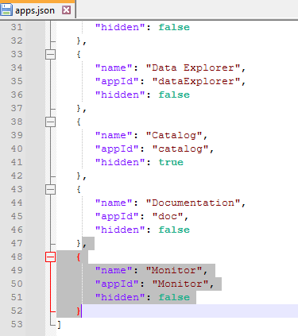
Implementation Steps (part 2 – apps.json)
Add additional entry for the “Monitor” application in the apps.json file.
File location is typically:
Windows: C:\K2View\Fabric_8.1\Server\fabric\staticWeb
Linux: ${K2_HOME}/fabric/staticWeb
The JSON section to be added is:
{ "name": "Monitor",
"appId": "Monitor",
"hidden": false
}

Slide 9
Implementation Steps (part 3.1 – config MTable)
Fill the mtMonitorConfig Mtable with the steps of the process:
Step Number – Identification number of the step (Recommended: start with 1 and increase sequentially)
Step Name – name of the step as it should appear on the monitor
Type – Specify if the step is a “main process” or a “Sub-process”:
MAIN – step is a main process
SUB – step is a sub-process
Parent Steps – indicates the parent(s) of a step.
For MAIN step, points to the previous main step(s).
For the 1st main process, the “Parent Steps” should be 0 (zero).
For SUB step, points to the parent MAIN step
API Name – name of the API that will be called to get the step status.
These APIs must be implemented in the project
A SUB step may not have API name; in such case, the monitor expects the parent step API to return the status of the MAIN step and all it’s SUB steps.
Refresh Interval – number of seconds between refreshes of the data
Active Ind – “1” (active) / “0” (inactive) indicator,
“Inactive” steps are not presented on the monitor (not the execution)

Slide 10
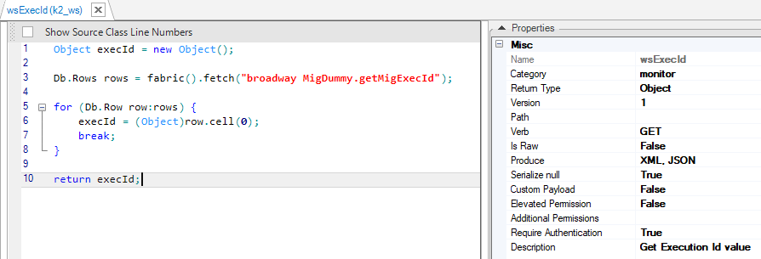
Implementation Steps (part 3.2 – wsExecId)
wsExecId is a Web-Service that should return the current run Id.
The run-Id returned by this WS is presented on the monitor.
It is also passed as parameter when calling the various step status WSs listed in mtMonitorConfig.
The WS gets no parameters.
It should support at least the GET verb, and return a JSON object, on this format:
{"execId": “<value>"}
For example:
{"execId": "96"}

Slide 11
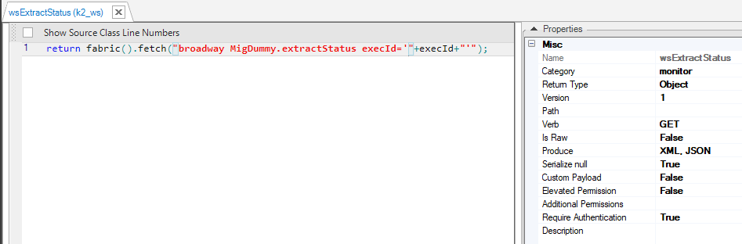
Implementation Steps (part 3.3 – Step Status WSs)
Each WS (API) listed in mtMonitorConfig must be implemented.
The WS gets one input parameter, “execId”, of type string.
It should support at least the GET verb, and return a JSON object, on this format:
{
"name": "<step name>", à the name of the step or sub-step, matching the "step name" column in the configuration table
"status" : "<step status>",à the step process status: "pending", "running", "failed", "completed"
"completed": "<completed objects count>",à count of the objects already completed by the process
"rejected": "<rejected objects count>",à count of the objects rejected by the process
"in process": "<in-process objects count>",à count of objects currently in-process
"pending": "<pending objects count>",à count of the objects still pending to be processed
"subProcesses": [ à an array of the sub-processes included in the process (optional)
"name": "<step name>", à the name of the sub-step, matching the "step name" column in the configuration table
"status": "<step status>", à the sub-step process status: "pending", "running", "failed", "completed"
"completed": "<completed objects count>", à count of the objects already completed by the process
"rejected": "< rejected objects count >", à count of the objects rejected by the process
"in process": "< in-process objects count >", à count of objects currently in-process
"pending": "< pending objects count >", à count of the objects still pending to be processed
]
}
If a WS is specified for a SUB-step, it should not include the “subProcesses” section
If WSs are not specified for SUB-steps, the parent MAIN-step WS must include the “subProcesses” section, with an entry for each SUB-step

Slide 12
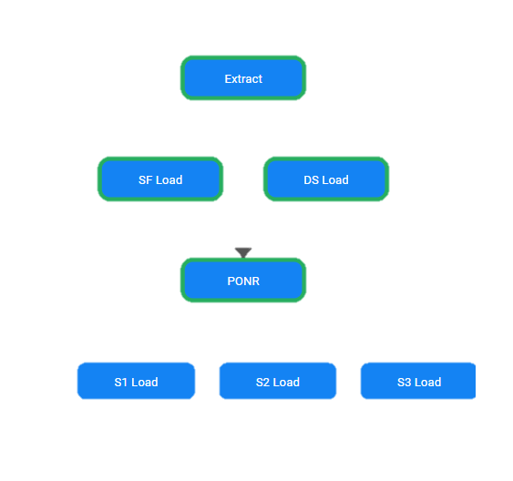
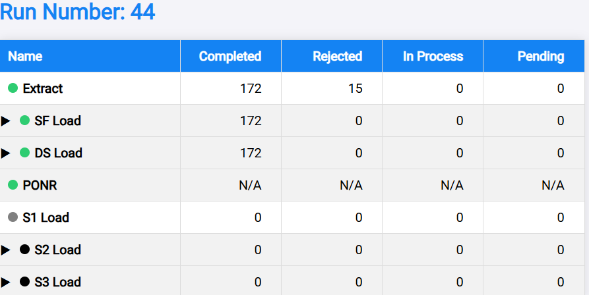
Code Analysis & Explanation
An Overview of the HTML, CSS, and JavaScript Modules

Slide 13
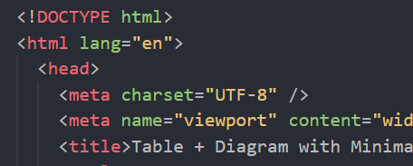
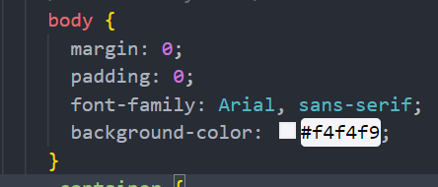
Overall Structure
HTML Document: HTML5 page declared with <!DOCTYPE html>, language set to English.
Head Section: Contains metadata (character encoding, viewport settings, title) and internal CSS styles.
Body Section: Divided into Table Section (process status data) and Diagram Section (interactive SVG diagram with zoom, pan, and minimap).

Slide 14
CSS Styling – Global & Layout
Global Styles:
Resets margins and paddings;
uses Arial, sans-serif with a light background.
Layout:
container uses Flexbox (horizontal row) to split the screen;
media queries adjust for smaller screens (vertical stacking).

Slide 15
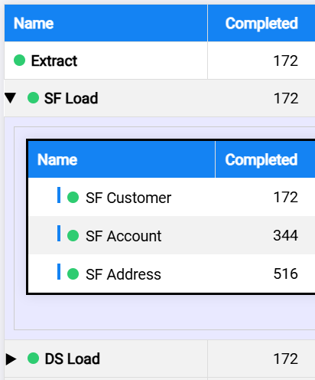
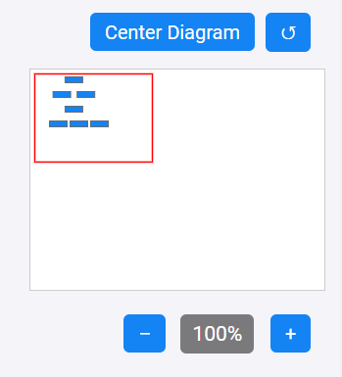
CSS Styling – Table & Diagram/Minimap
Table Styling: Fixed layout with defined column widths; blue headers with white text; alternating row colors; expandable rows and sub-rows styling.
Diagram & Minimap: .diagram-container enables panning; zoom controls, center and reset buttons are absolutely positioned; main SVG fills container; minimap shows a red viewport reflecting current view.

Slide 16

JavaScript Modules – Utility Functions
Module: Utils
Purpose: Provides helper functions used across the code.
Key Functions: safeJsonParse, showError/hideError, debounce.

Slide 17

JavaScript Modules – Data Manager (Part 1)
Module: DataManager
Purpose: Central module for fetching, processing, and scheduling data refreshes.
Initialization: Hides error messages, loads initial data from web services, initializes table and diagram views, sets up periodic refresh intervals.

Slide 18
JavaScript Modules – Data Manager (Part 2)
Data Loading:
Fetches execution ID (wsExecId) and configuration steps (wsMonitorConfig);
uses a timestamp fallback if needed.
API Responses:
Retrieves data for each process step using invokeFabricWebService and aggregates responses.
Parsing:
Uses regex (and manual fallback) in parseStatus to extract process details
(status, name, completed, etc.).

Slide 19
JavaScript Modules – Table View Module
Module:
TableView
Purpose:
Builds and manages the dynamic HTML table for process statuses.
Key Features:
Iterates over grouped main steps to create table rows;
handles sub-rows with an inner table;
updates rows with new data;
manages row selection and toggling sub-rows.

Slide 20
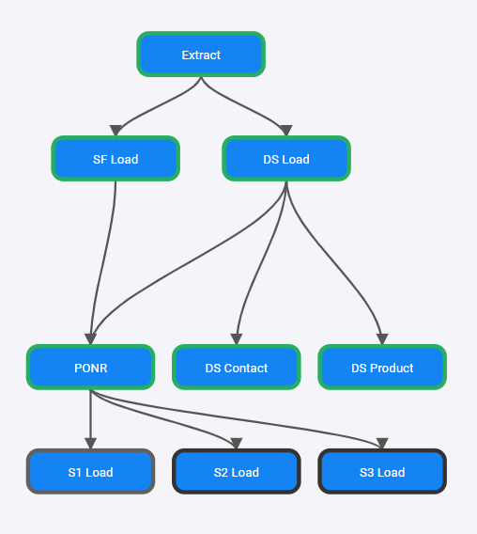
JavaScript Modules – Diagram View Module (Part 1)
Module: DiagramView
Purpose:
Renders an interactive SVG diagram representing process relationships.
Initialization:
Sets up event listeners for zoom, pan, reset, and center;
configures tooltips for node details.

Slide 21
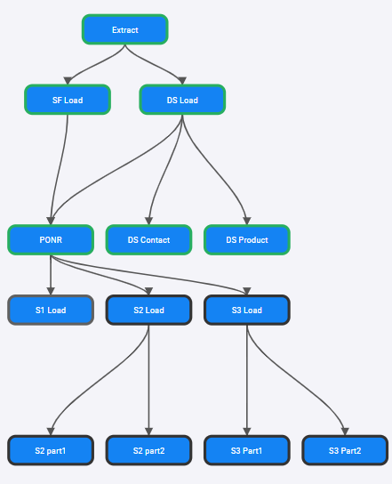
JavaScript Modules – Diagram View Module (Part 2)
Diagram Construction:
Computes layout (hierarchical levels, x and y coordinates) based on parent-child relationships.
Drawing:
Nodes are rendered as SVG groups (<g>) with rectangles and text;
edges drawn as SVG paths with Bézier curves.

Slide 22
JavaScript Modules – Diagram View Module (Part 3)
Zoom, Pan, & Minimap: Zoom in/out by adjusting the SVG’s viewBox; panning via mouse drag; minimap shows a scaled version of the main diagram with a red viewport.
User Interaction:
Nodes are clickable to expand/collapse subprocesses; tooltips provide additional details on hover.

Slide 23
Integration & Execution Flow
Initialization on Page Load:
Sets up navigation menu and calls DataManager.init() to fetch execution ID, configuration steps, and data;
builds table and diagram views.
User Interactions:
Table rows toggle sub-processes;
diagram nodes respond to clicks and hover;
periodic refresh updates both views.

Slide 24
Additional Comments
Code Modularity:
Organized into separate modules (DataManager, TableView, DiagramView, Utils) for clarity and maintainability.
Error Handling:
Robust error handling during data fetching and parsing;
error messages inform the user.
Dynamic UI Updates:
Uses event listeners for clicks, mouse movements, and window resizing to maintain an interactive interface.
Inline Comments

Slide 25
Summary & Questions
Overview: Code structure, styling, and modular JavaScript functionality.
Interaction: How the table and diagram interact and update dynamically.
Questions: Open for any further clarifications.

